Slide 1
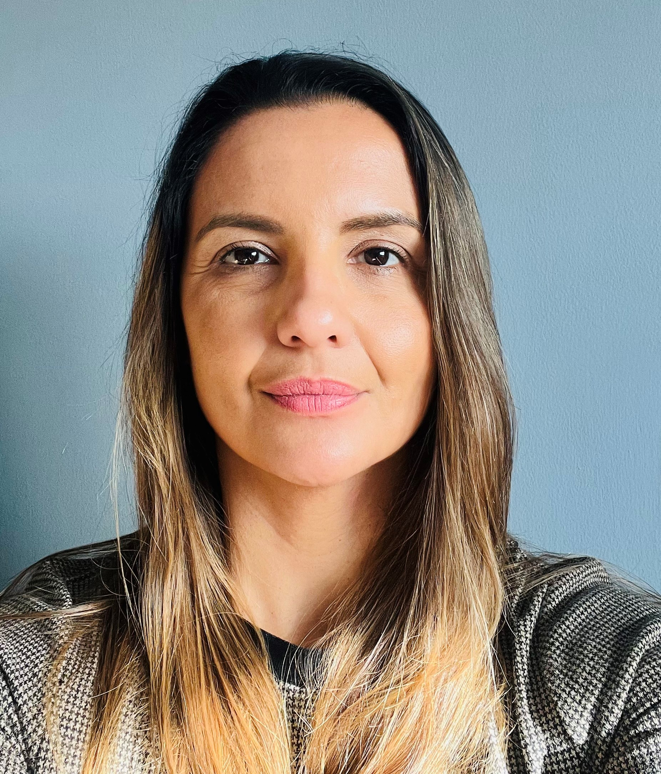
Mental Health Support Teams in Schools
Broxbourne
Hi, I’m Lia
I am an Education Mental Health Practitioner (EMHP)
In primary schools I can provide 1:1 parent support sessions, group work, assemblies and workshops to support children with anxiety and promoting positive behaviour.
In secondary schools I can provide one-to-one and group sessions for young people presenting with low to moderate mental health difficulties such as anxiety, phobias and low mood. I also provide psychoeducation workshops and small group sessions.
If you know a child, young person or parent/career who would benefit from this service, or you would like more information please contact the team.
Email: hpft.mhstbroxbourne@nhs.net
Tel: 07866 201723
Thank you
I am working with the Broxbourne Mental Health Support Team to help improve young people’s mental health and wellbeing.

