Slide 1

Children's Mental Health Week
Healthy Inside and Out

Slide 3
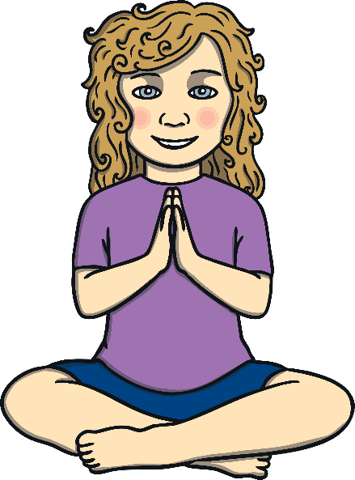
Welcome to a
Yoga Breathe and Feel Good Break
Sit Comfortably Make sure your body is comfortable before you start.
Breathe Evenly
Take smooth, easy and relaxed breaths.
Enjoy It!
Enjoy the feeling of wellbeing, inside and out.

Slide 4
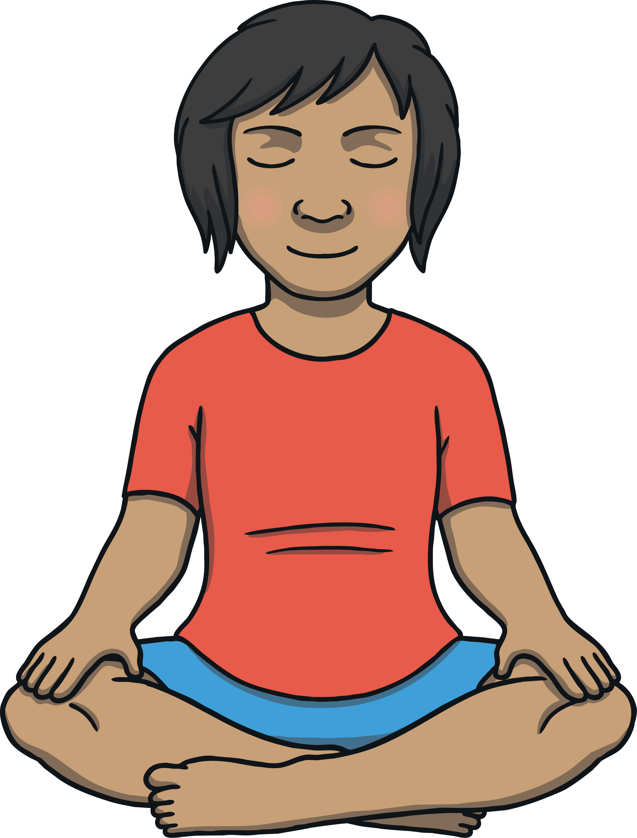
Crossed Legs Pose
Instructions:
Start in sitting.
Cross your legs comfortably and sit tall.
Breathe in and out evenly
and smoothly.
Make sure you don’t feel any stretch in your knees.
If you are finding this challenging, make the cross of the legs looser and further away from your body.
If you are ready for more, bring the knees closer to the body and the feet through.

Slide 5
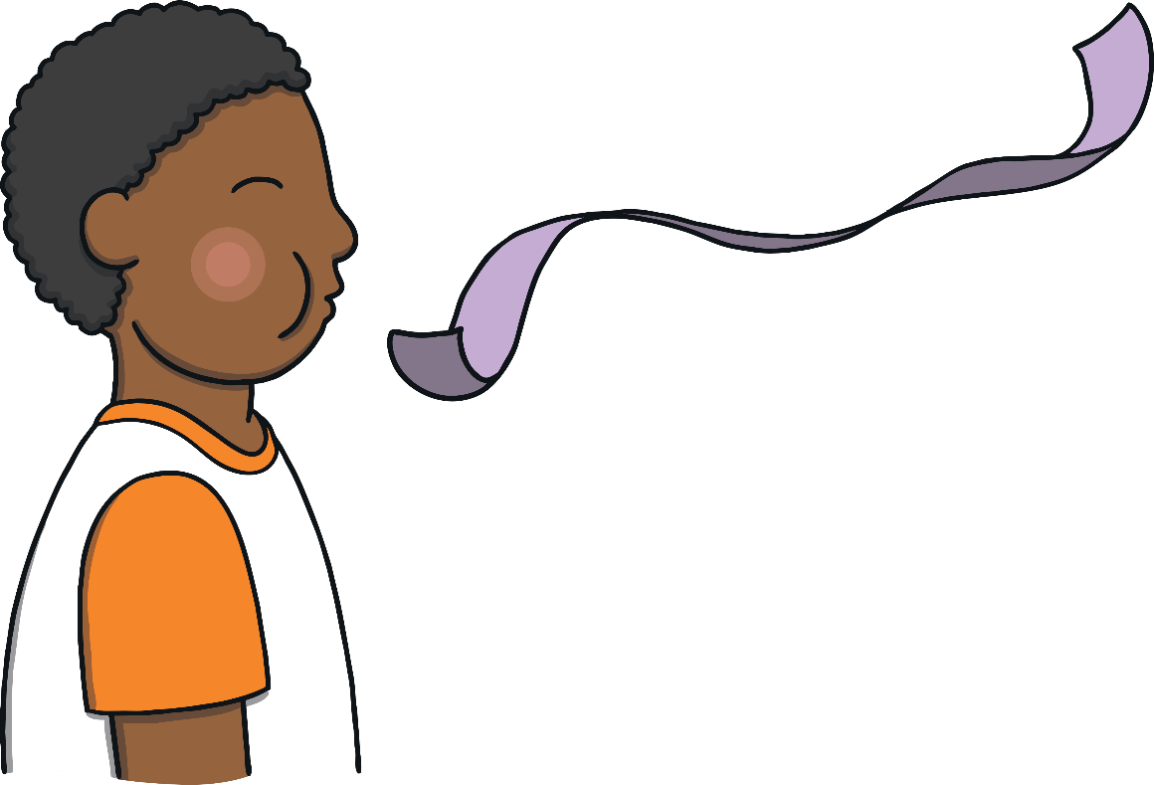
Ribbon Breathing Part 1
Instructions:
Sit comfortably and calmly.
As you breathe out, imagine you breath becomes a long smooth ribbon.
See how long can you make the ribbon.
Imagine each time you breathe out that your breath gets longer
and longer.
Breathe smoothly and evenly at all times.
If you are ready for more, lengthen your breath out.
If you are finding this challenging, make your breath out easy.

Slide 6


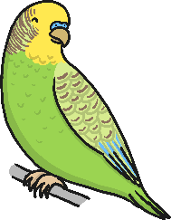



Ribbon Breathing Part 2
Instructions:
Imagine your breath out makes a picture of your favourite animal.
See your animal clearly.
Maybe it waves to you or tells you a special message.

Slide 7
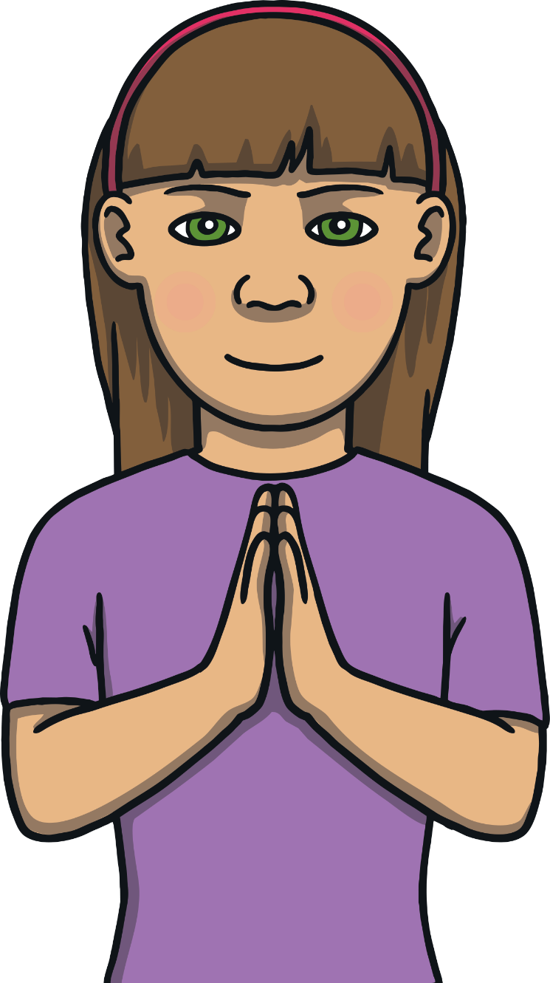
Prayer Pose
Instructions:
Start in a comfortable
sitting position.
Bring the palms of your hands together.
Breathe in and out.
Breathe steadily and evenly.
Enjoy a feeling of quiet and calm.
If you are finding this challenging, bring only your fingertips together.
If you are ready for more,
sink your
shoulders down.

Slide 8

Take this feeling of wellbeing around with you all day.

